Slide 1


Recycling Incentives
Team name – Name IT

Slide 2
Problem
Recycling rates
People are not recycling more

Slide 3
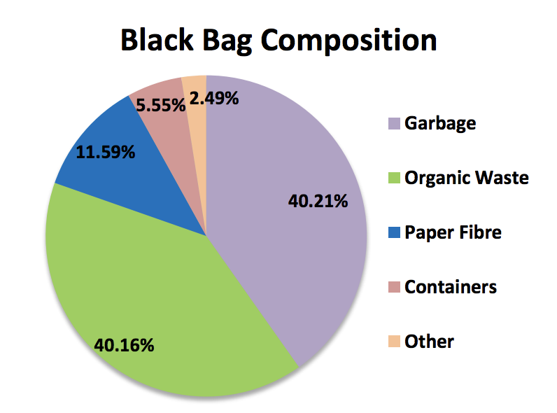
Supporting information
82%
Users are constantly searching for a solution
From the waste audit

Slide 4
Solution
The goal of our app to motivate the residents in Mount Pearl to Recycle.

Slide 5
Rewards
Monetary rewards
-- Gym membership
-Transit Pass
Non Monetary rewards
-Social media appreciation post
Notes:
Jaladhi

Slide 6
Hardware

Slide 7
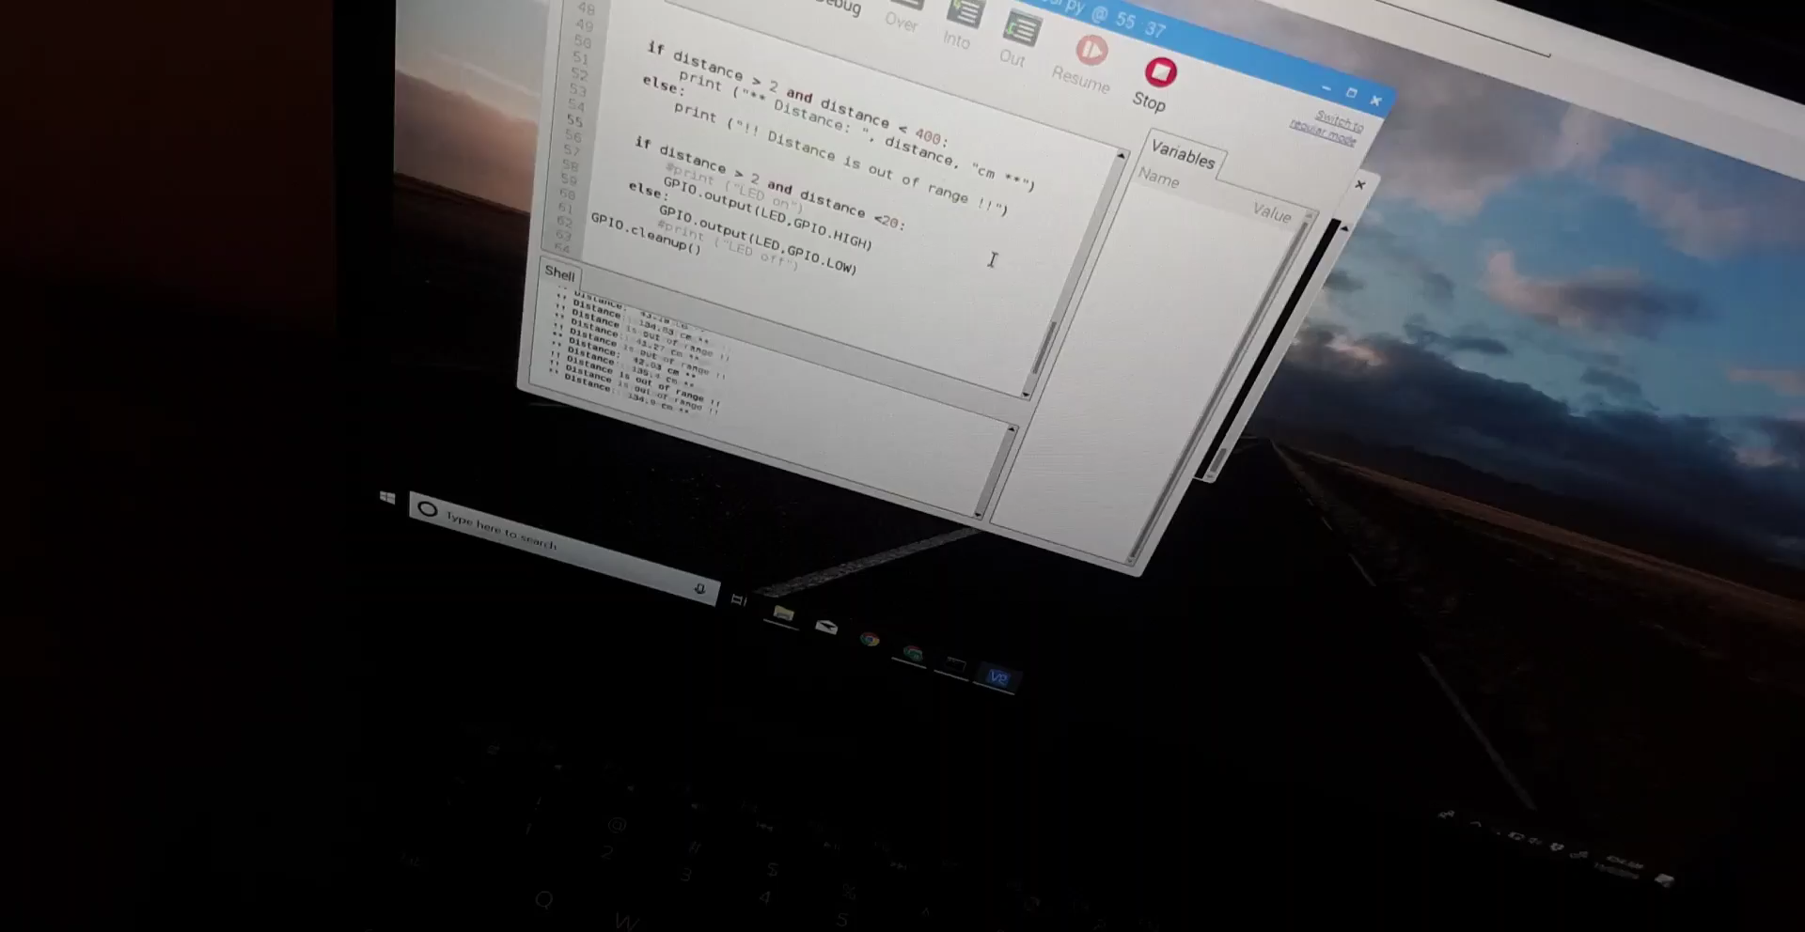
Hardware

Slide 8
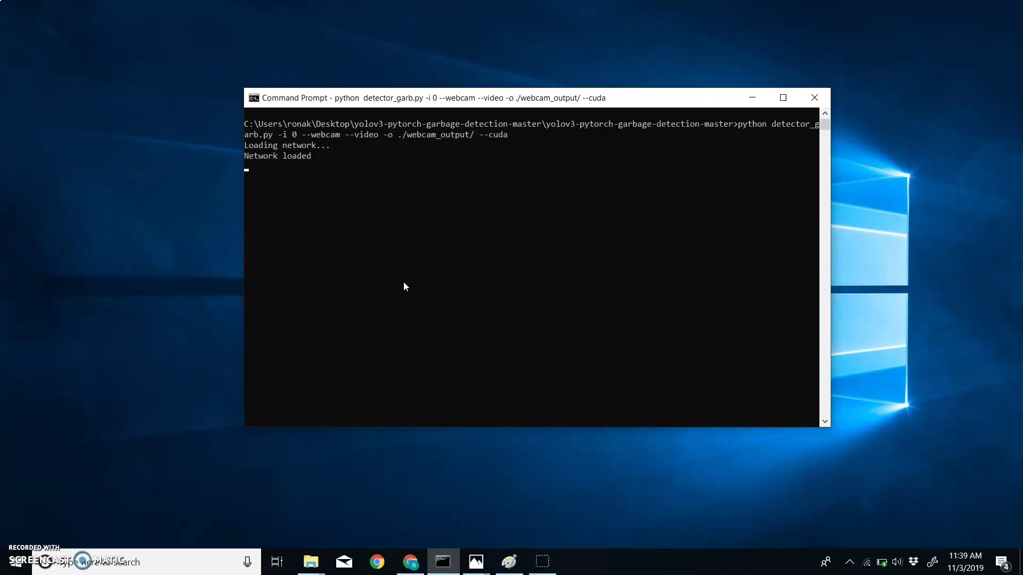
Image Recognition

Slide 9
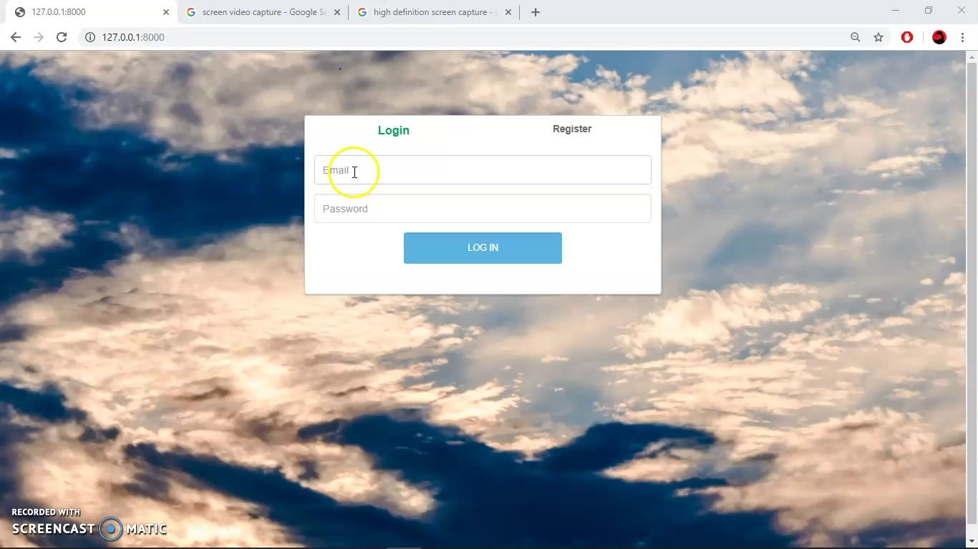
Solution Proposal

Slide 10
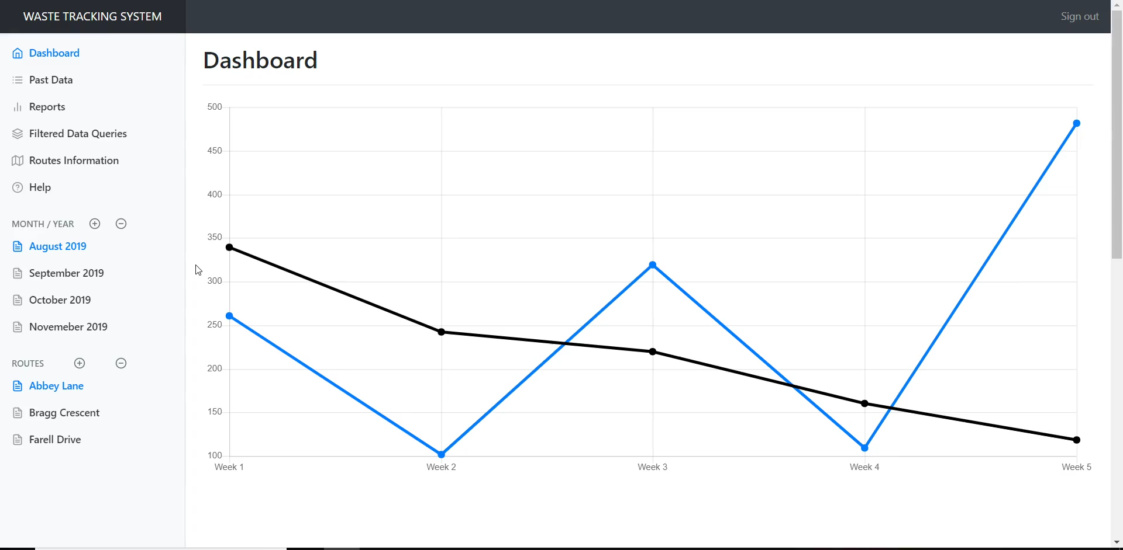

Slide 11
Cost and its impact on Budget

Slide 12
Thank you Questions?

